Slide 1

TLS 1.3
Dima Ionut Daniel

Slide 2
Contents
What is TLS?
History
Cryptography
SSL
SSL Formats
TLS 1.2 vs TLS 1.3
Core
Browser Support
Message Format
Bibliography

Slide 3

What is TLS?
Transport Layer Security (TLS) and its predecessor, Secure Sockets Layer (SSL) are cryptographic protocols that provide communications security over a computer network.
The primary goal of the Transport Layer Security protocol is to provide privacy and data integrity between two communicating computer applications.
The connection is private because symmetric cryptography is used to encrypt the data transmitted.
TLS 1.3 is described in RFC 8446

Slide 4
What is TLS? (cont.)
The keys for this symmetric encryption are generated uniquely for each connection and are based on a shared secret negotiated at the start of the session (TLS handshake protocol).
The server and client negotiate the details of which encryption algorithm and cryptographic keys to use before the first byte of data is transmitted.
The negotiation of a shared secret is both secure and reliable (no attacker can modify the communications during the negotiation without being detected).
The identity of the communicating parties can be authenticated using public-key cryptography.

Slide 5
History
Netscape developed the original SSL protocols.
Version 1.0 was never publicly released because of serious security flaws in the protocol; version 2.0, released in February 1995, "contained a number of security flaws which ultimately led to the design of SSL version 3.0".
Released in 1996, SSL version 3.0 represented a complete redesign of the protocol produced by Paul Kocher working with Netscape engineers Phil Karlton and Alan Freier, with a reference implementation by Christopher Allen and Tim Dierks of Consensus Development.
Newer versions of SSL/TLS are based on SSL 3.0.
The 1996 draft of SSL 3.0 was published by IETF as a historical document in RFC 6101.
SSL 2.0 was deprecated (prohibited) in 2011 by RFC 6176.
SSL 3.0 was deprecated in June 2015 by RFC 7568.

Slide 6
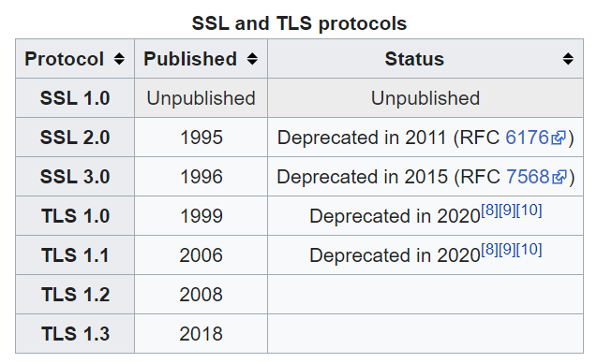
History (cont.)
TLS 1.0 was first defined in RFC 2246 in January 1999 as an upgrade of SSL Version 3.0 and written by Christopher Allen and Tim Dierks of Consensus Development.
TLS 1.1 was defined in RFC 4346 in April 2006, as an update from TLS version 1.0.
TLS 1.2 was defined in RFC 5246 in August 2008 and is based on the earlier TLS 1.1 specification.
TLS 1.3 proposed as new standard in March 2018

Slide 7
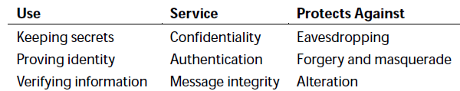
Cryptography
Cryptography is derived from the Greek for "secret writing".
To validate the information cryptographic functions called hash functions are used.
Cryptographic hash functions resemble checksums or cyclic redundancy check (CRC) codes that are common error detection mechanisms.
2 particular hash functions are essential to SSL implementations: Message Digest 5(MD5) and Secure Hash Algorithm(SHA)

Slide 8
Cryptography (cont.)
There are 2 cryptographic techniques:
secret key
public key
With secret key cryptography both parties know the same information: the key and the endeavor to keep that key secret.
Because the secret is known by both parties the technique is called symmetric encryption.
The information after encryption process is called cipher text.

Slide 9
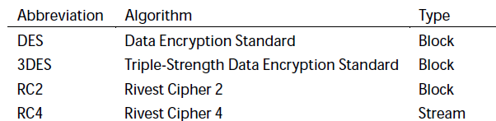
Cryptography (cont.)
Ciphers may be either: stream ciphers or block ciphers.
Stream ciphers process input data a byte at a time and can accept any size of input for encryption.
Block ciphers operates only on fixed-sized blocks of data, typically 8 bytes in size.
Block ciphers require less computation resources.
Encrypting data using a block cipher requires breaking the data into blocks.
If the last block doesn't contain exactly the right amount of data then dummy data is filled (padding).

Slide 10
Cryptography (cont.)
Public key(asymmetric) cryptography actually has each of the 2 parties use separate keys:
one for encryption (public key)
another one for decryption (private key)
Public key encryption is powerful but extremely complex.
A good approach is to share the secret key over a secure channel done with public/private keys.
This special type is algorithm is known as key exchange algorithm.

Slide 11
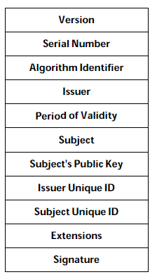
Cryptography (cont.)
Public key certificates contains lots of information like:
issuer: identifies the organization that has issued the certificate
period of validity: certificates expire after a certain time.
subject: issuer's signature

Slide 12
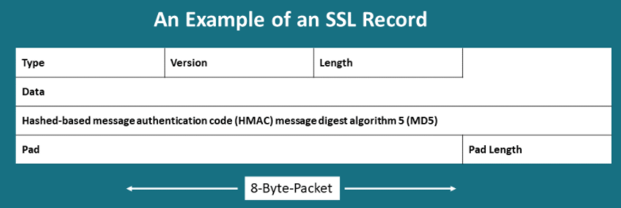
SSL
SSL(Secure Sockets Layer) it permits to access encrypted information through Public Key Infrastructure, and secondly, it helps authenticate the identity of the owner of the SSL certificate.
The SSL Record Protocol is responsible for handling encryption of all messages.
The SSL Alert Protocol provides SSL related alerts, as it is responsible to handle questionable type of packets.
It handles three different types of alert messages: Warning, Critical, Fatal.

Slide 13
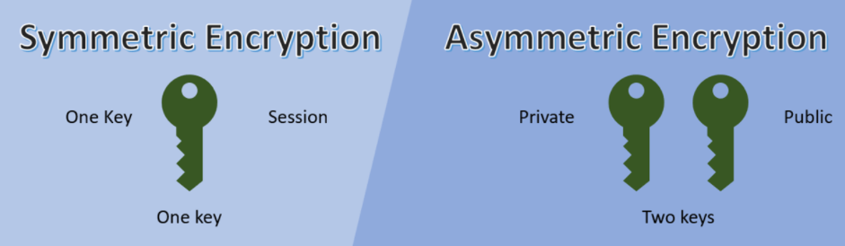
SSL (cont.)
A single key is used by symmetric encryption and it's shared among people who are looking to receive the message. Symmetric encryption is the encryption method which involves one secret key to cipher and decipher the information. Asymmetric encryption eliminates the sharing of the key by making using of a pair of public-private keys.

Slide 14
SSL (cont.)
Key Exchange Algorithm assures confidentiality at the time of data transmission though different secure file transfer protocols such as HTTPS, the data needs to be encrypted.
Authentication Algorithms ensure and correct data transmission must verify the identity of the user who will have access to the data.
Bulk encryption algorithm is used to ensure the secure transmission of data. Widely used: CAMELLA, AES, 3DES.
MAC(Message Authentication Code) algorithms is used for the verification and authentication of the received message.

Slide 15
SSL (cont.)
GCM(Galois Counter Mode) is a type of cipher mode, a block of operation which used universal hashing over a binary Galois field to offer authenticated encryption and authenticated decryption. It's a mode of operation for symmetric key cryptographic block ciphers widely used due to their performance and efficiency.
CRS(Cyclic Redundancy Check) algorithms are used to hep at a certain level of randomly detecting damaged parts of the messages.

Slide 16
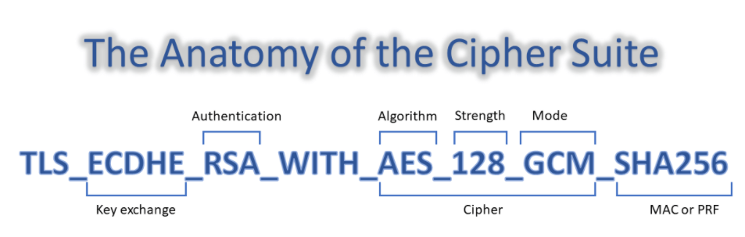
SSL (cont.)

Slide 17
SSL Formats
An SSL certificate is also known as X.509 certificate, where X.509 is a set of standards which defines the structure of the certificate.
It uses a format language known as Abstract Syntax Notation One (ASN.1) to describe the data structure of the certificate.

Slide 18
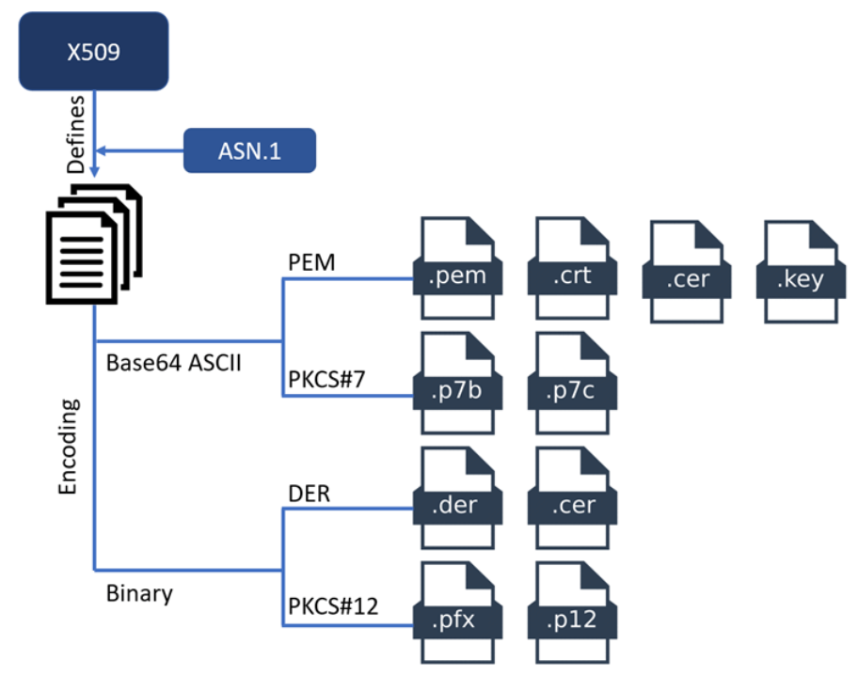
SSL Formats (cont.)

Slide 19
SSL Formats (cont.)
Certificate Authorities (CA) provide certificates in PEM format which are encoded files in Base64 ASCII. The file type of this certificate can be .crt, .pem or .key.
PKCS#7 format is a Cryptographic Message Syntax Standard which uses a Base64 ASCII encoding fie with .p7b or .p7c extension. This certificate can be stored and not its private keys.
DER formats are mainly used for Java web applications, and they are in binary form with an extension of .der or .cer files.
PKCS#12 certificates are mostly used in Windows platform and have .pfx and .p12 extensions.

Slide 20
TLS 1.2 vs TLS 1.3
TLS 1.2 handshake
Client sends a message to the server and offers a list of encryption protocols it can support.
Server then replies with the protocol it intends to use and sends an encryption key
Client then uses that key to send back a random string, and they create 2 keys: master key and a weaker session key.
The Client selects which protocol it will use for the weaker session key. Because this key is weaker, it's faster and less resource-intensive.
The Server acknowledges the session key and protocol
They finally start exchanging information

Slide 21
TLS 1.2 vs TLS 1.3 (cont)
TLS 1.3 handshake
The client says hello and says which protocol it intends to use
The server says: "Ok! Here's my key !"
The Client says "Nice! Here's the session key !"

Slide 22
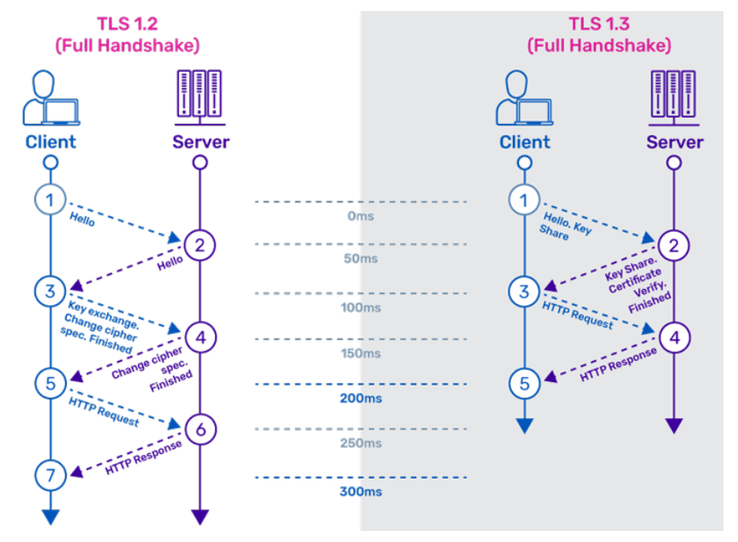
TLS 1.2 vs TLS 1.3 (cont)

Slide 23
Core
TLS 1.3
removed support for older/vulnerable encryption standards: MD5, SHA-224.
improves the latency of connection requests
simplifies the handshake
removed compression and renegotiation

Slide 24
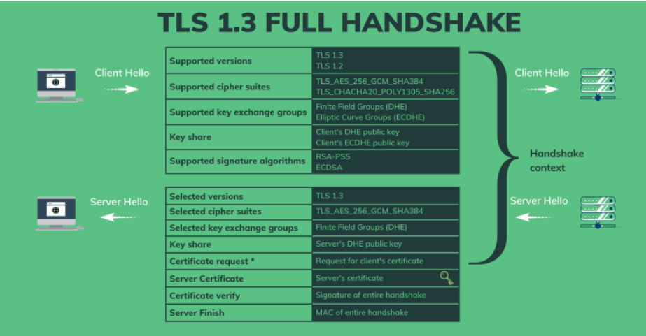
Core

Slide 25
Core (cont.)
The TLS 1.3 full handshake starts with a hello message that the client sends to the server:
a list of protocol version that client supports.
list of supported AEAD symmetric cipher suites. In this case, there are 2 options: AES-256-GCM or CHACHA20-POLY1305
a list of supported key exchange groups: Finite field Diffie-Hellman Ephemeral and Elliptic-Curve Diffie-Hellman Ephemeral
a list of signature algorithms it supports.

Slide 26
Core (cont.)
After receiving the client hello message, the server also sends back its hello message, which contains:
selected protocol version TLS 1.3
selected cipher suites: AES-256-GCM
selected key exchange method: Diffie-Hellman Ephemeral
the server’s public key for that chosen method
next field is a request for the client’s certificate, which is optional and will only be sent if the server wants to authenticate the client by its certificate

Slide 27
Core (cont.)
TLS 1.3 shrinks the size of the cipher suites used for encryption.
TLS relies on key exchanges to establish a secure connection. In earlier versions, keys could be exchanged during the handshake using one of the 2 mechanism: a static RSA key or a Diffie-Hellman key.
The RSA has been removed, along with all static (non-PFS) key exchanges, while retaining ephemeral Diffie-Hellman keys.

Slide 28
Browser Support
Chrome has been shipping a draft version of TLS since version 65.
Chrome 70 (released in October 2018) has support of final version of TLS 1.3.
A draft version of TLS 1.3 was implemented in Firefox 52 and from version 63 the final version of TLS 1.3.
Microsoft Edge started supporting TLS 1.3 from version 76.

Slide 29
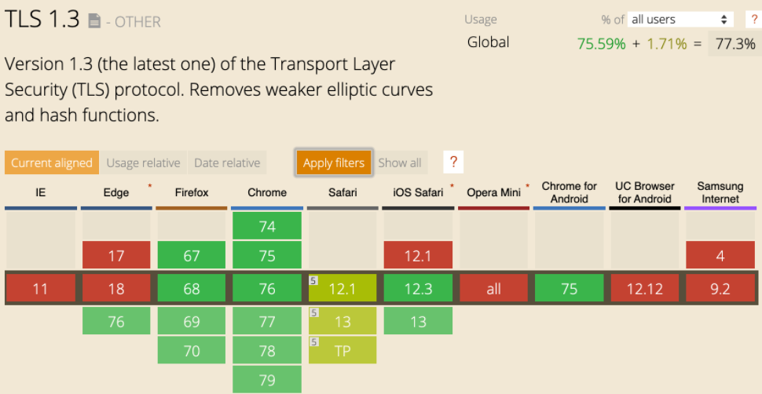
Browser Support (cont.)

Slide 30

Bibliography
https://en.wikipedia.org/wiki/Transport_Layer_Security
Wiley - SSL and TLS Essentials
https://kinsta.com/blog/tls-1-3/
https://aboutssl.org/ssl-guide/
https://datatracker.ietf.org/doc/rfc8446/

